Slide 1

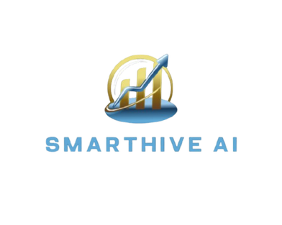
REVOLUTIONIZING CUSTOMER SEGMENTATION FOR SMALL BUSINESSES IN KENYA
Group Members:
Diana Jerusha Olulo - AI/ML Engineer
Sharon Mwikali Kitavi - Data Analyst.
Buheli Esther Taifa - AI/ML Engineer.
Eli John Mwoho - Software Developer
Rita Njoki Omondi - Software Developer
University:
Catholic University Of Eastern Africa
Presented by: SmartHive AI

Slide 2

PROBLEM STATEMENT
Overview:
In the competitive retail landscape of Kenya, small businesses frequently encounter significant obstacles in effectively targeting and engaging a diverse customer base.
Ineffective marketing strategies lead to substantial waste of marketing budgets, resulting in cost increase of up to 30% and declines in customer retention rates by 20%.
Supporting Research:
Research conducted by Mutua and Wachira (2020) underscores the adverse impact of poor marketing strategies, linking them to reduced customer loyalty and heightened churn rates.

Slide 3




SOLUTION OFFERED:
SmartHive AI presents a comprehensive web application designed specifically for small businesses. This platform enables marketing teams to visualize customer segments, execute targeted campaigns, and monitor performance in real-time.
Utilization of Cutting-Edge Technology:
Our solution employs advanced artificial intelligence and machine learning algorithms to ensure precise customer segmentation.
The integration of data visualization tools facilitates the transformation of complex datasets into actionable insights, thereby enhancing the decision-making process for marketing teams.

Slide 4

METHODOLOGY
Data Collection
Downloaded dataset from Kaggle.
Cleaned the data and extracted new features(feature Engineering)
Data preprocessing
EDA
Explored the data to uncover patterns , trends and gain valuable insights.
Utilized machine learning cluster algorithms ; Kmeans, and hierarchial clusteringto segment the customersand evaluated the models.
Modelling
Deployment
Deployed the model using flask to create a web based application

Slide 5

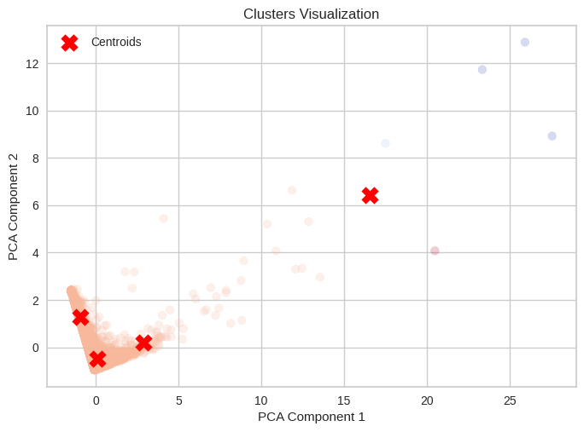
CUSTOMER SEGMENTATION
Targeted Insights
The models have identified 4 distinct customer clusters, allowing us to tailor our marketing and product strategies to each segment's unique needs and preferences.
Diverse Profiles
The customers within each cluster share similar behaviors, purchasing patterns, and demographics, enabling us to develop personalized campaigns that resonate with their specific motivations.
👆🏼

Slide 6


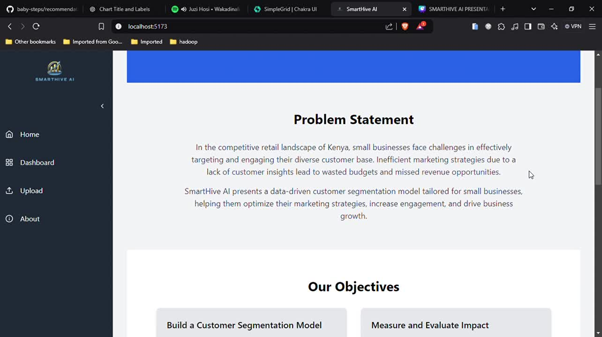
DEMO

Slide 7


RETURN ON INVESTMENT
The potential for commercialization of SmartHive AI is substantial, as our solution aims to enhance marketing effectiveness and improve customer retention.
We project a 15% increase in revenue and a 25% enhancement in customer retention through optimized marketing strategies, demonstrating the financial benefits of adopting our system.
Research by Deloitte and McKinsey has shown that businesses using data-driven customer segmentation often see revenue increases ranging from 10% to 20% as a result of more precise targeting and reduced marketing waste.

Slide 8
LIMITATIONS
Access to Local Data: Obtaining significant and reliable local data presented a challenge, which impacted the specificity of insights available.
File Upload Efficiency: The web application currently requires substantial processing time for large file uploads, as these are computationally intensive.
Session Persistence: At this stage, our web app does not retain previous results, requiring users to reprocess data in each session as needed.

Slide 9
REFERENCES
McKinsey & Company. (2020). The next-generation personalization ecosystem. Retrieved from https://www.mckinsey.com
Deloitte Insights. (2019). The value of customer data: Improving customer experience and revenue growth with targeted segmentation. Retrieved from https://www2.deloitte.com

Slide 10

Thank You!
Collaboration
Github

